Slide 1
Introduction of Webservices
Service delivered over the web?

Slide 2
What is a Web Service
In simple words, services that can be accessed over network are called web services. So how does it differ from web application, they are also services that are accessed over network. There are few attributes that clarifies this difference.

Slide 3
Web applications are meant for users and to be accessed in browser having human readable format whereas web services are meant for applications to access data in the format of XML, JSON etc.
Web applications always use HTTP/HTTPS protocol whereas traditional web services use SOAP protocol. Recently REST is getting popularity that is an architecture style and almost all times run on HTTP/HTTPS protocol.
Web applications are not meant for reusability whereas this is one of the benefit of web services. A single web service can be used by different kinds of applications.

Slide 4
Web application can access web services to access some data or to perform some tasks, web services can’t access web applications to fetch some data.
Web applications are capable to maintain user session, web services are stateless.

Slide 5
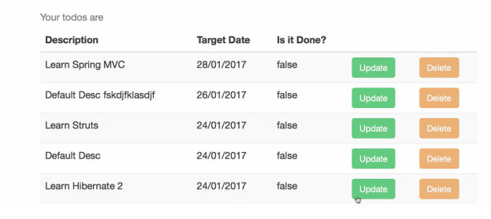
To do Application
Is the Todo Management Application a Web Service?

Slide 6
It delivers HTML output - Not consumable by other applications.
WEB
BUSINESS
DATA

Slide 7
Can I reuse the Business Layer by creating a JAR?
Not Platform independent
Communication of Changes
Managing Dependencies - like Database

Slide 8
How can I make my Todo application consumable by other applications?
That where we get into the concept of a web service!

Slide 9
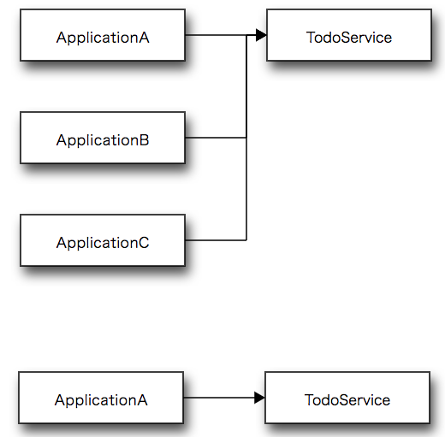
Webservice

Slide 10
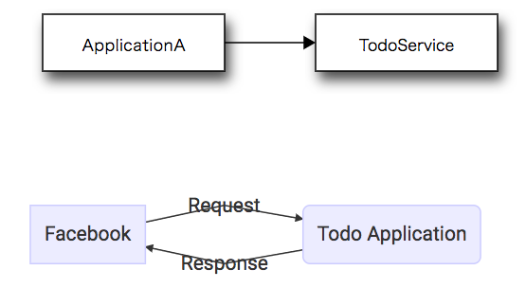

Slide 11
Web Service - W3C definition
Software system designed to support interoperable machine-to-machine interaction over a network
3 Keys
Designed for machine-to-machine (or application-to-application) interaction
Should be interoperable - Not platform dependent
Should allow communication over a network

Slide 12
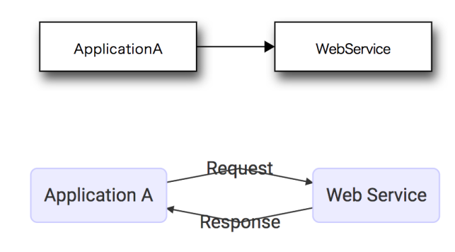
How?
How does data exchange between applications take place?

Slide 13
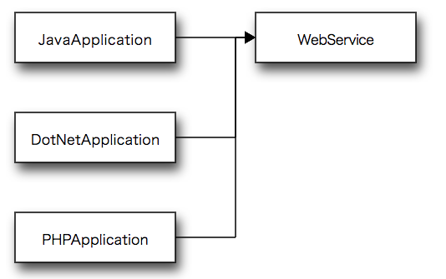
How can we make web services platform independent?

Slide 14
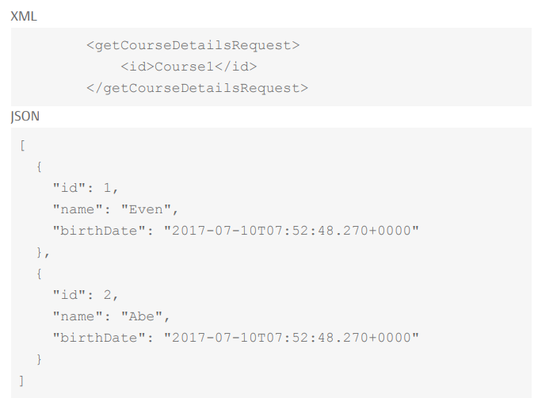
Request & Response Format

Slide 15
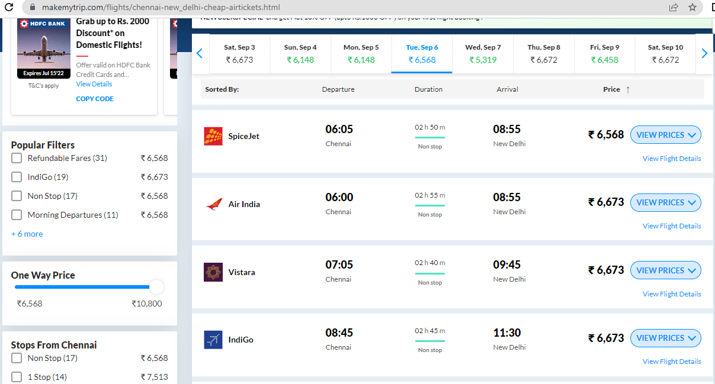
https://www.makemytrip.com/flights/chennai-new_delhi-cheap-airtickets.html

Slide 16
Types of Web Services
There are two types of web services.
SOAP: SOAP stands for Simple Object Access Protocol. SOAP is an XML based industry standard protocol for designing and developing web services. Since it’s XML based, it’s platform and language independent. So our server can be based on JAVA and client can be on .NET, PHP etc. and vice versa.
REST: REST is an architectural style for developing web services. It’s getting popularity recently because it has small learning curve when compared to SOAP. Resources are core concepts of Restful web services and they are uniquely identified by their URIs.

Slide 17
Medium- HTTP
Format – XML, JSON ..etc

Slide 18
Java Web Services
Java provides it’s own API to create both SOAP as well as REST web services.
JAX-WS: JAX-WS stands for Java API for XML Web Services. JAX-WS is XML based Java API to build web services server and client application.
JAX-RS: Java API for RESTful Web Services (JAX-RS) is the Java API for creating REST web services. JAX-RS uses annotations to simplify the development and deployment of web services.
Both of these APIs are part of standard JDK installation, so we don’t need to add any jars to work with them. Both of these APIs use annotations very heavily.

Slide 19
REST
Representational State Transfer
REST is a style of software architecture for distributed hypermedia systems

Slide 20
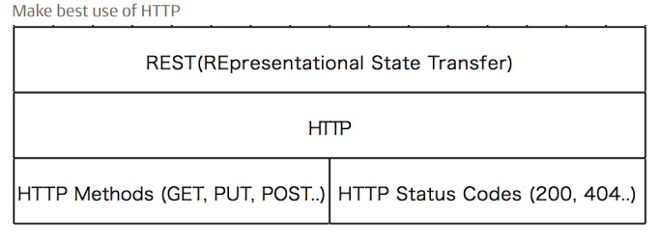

Slide 21
Following are some common HTTP response codes along with their meanings, that we will encounter when working with the WP REST API and their meanings:
200 – OK: Means that the request has been completed successfully and the server has returned the response. Usually returned after a successful GET request. 201 – Created: Usually returned after a successful POST request. Summarizes that the resource has been created. 400 – Bad Request: It’s returned from the server when a request was sent with some missing or invalid parameters. Usually returned in response to POST or PUT requests. 401 – Unauthorized: Means that user was not authorized to perform certain action. For example, a user tried to create or delete a resource without providing authentication credentials. 403 – Forbidden: Means that server understood the request but refused to complete it due to authentication. It happens when a user provides authentication

Slide 22
Introduction of Spring Framework

Slide 23
Getting started with spring Framework-Goals
Build a Loose Coupled Hello World Gaming App with Modern Spring Approach.
Get Hands-on with Spring and understand:
Why Spring?
Terminology
Tight Coupling & Loose Coupling
IOC Container
Application Context
Component Scan
Dependency Injection
Spring Beans
Auto wiring

Slide 24
Loose Coupling with Spring Framework
Design Game Runner to run games:
Mario, Super Contra, PacMan etc
Iteration 1: Tightly Coupled
GameRunner class
Game Classes : Mario, Super Contra, PacMan etc.
Iteration 2: Loose Coupling – Interfaces
GameRunner class
GamingConsole interface
Game Classes : Mario, Super Contra, PacMan etc

Slide 25
Iteration 3: Loose Coupling – Spring
Spring framework will manage all our objects!
GameRunner class
GamingConsole Interface
Game Classes : Mario, Super Contra, PacMan etc
In Spring Framework can we Managing the creation & and the life cycle of the object that we are creating ?

Slide 26
Game Runner
Mario
Super Contra
PacMan

Slide 27
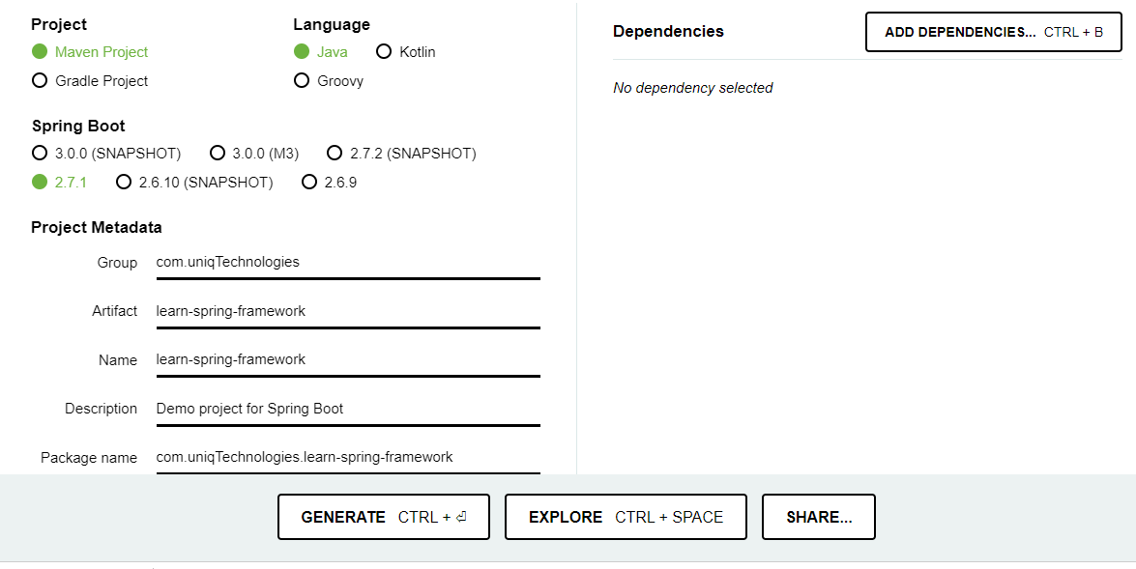
https://start.spring.io/

Slide 28
Spring Framework Questions
Question 1: What's happening in the background ?
Lets debug
Question 2: What about the terminology? How does it relate to what we are doing?
Dependency , Dependency Injection, IOC Container , Application context , Component scan , Spring beans , Auto wiring etc !
Question 3: Does the spring Framework really add value ?
We are replacing 3 simple lines with 3 complex lines!
Question 4: what if I want to run super Contra game ?
Question 5: How is spring Jar downloaded?
magic of maven!

Slide 29
@Primary & @Qualifier
@Primary – it tells spring, “when you find more than one beans that both can be Autowired, please use the primary one as your first choose.
@Qualifier-will tell spring , “ no matter how many beans you have found , just use the one I tell you.”

Slide 30
So you can find both @Qualifier and @primary are telling spring to use the specific bean when multiple candidates are qualified to Autowired.
But @Qualifier is more specific and has high priority. So when both @Qualifier and @Primary are found, @primary will be ignored.

Slide 31
What's happening in the background ?
Application.properties
logging.level.org.springframework=DEBUG
Lets Debug:
Identified candidate component class: file [GameRunner.class]
Identified candidate component class: file [MarioGame.class]
Identified candidate component class: file [PacManGame.class]
Identified candidate component class: file [SuperContraGame.class]
Creating shared instance of singleton bean 'gameRunner‘
Creating shared instance of singleton bean 'pacManGame'
Autowiring by type from bean name 'gameRunner' via constructor to bean named 'MarioGame'

Slide 32
Spring Framework- Important Terminology
@component – class managed by spring framework
Dependency – GameRunner needs GamingConsole impl!
GamingConsole impl(Ex: MarioGame) is a dependency of GameRunner
Component Scan : How does Spring Framework find Component classes?
It scans packages (@componentScan(“com.uniqTechnologies.learnspringframework”))
Dependency Injection: Identify beans, their dependencies and wire
them together (provides IOC – Inversion of Control)
Spring Beans : An object managed by spring framework
IOC Container : Manages the lifecycle of beans and dependencies
Types : Application context & BeanFactory
Autowiring : Process of wiring in dependencies for a spring bean.
We gave the responsibility to spring container for object creation that is IOC

Slide 33
Does the spring Framework really add value
In Game Runner Hello world App, we have very few classes
But Real world applications are much more complex:
Multiple Layers (web, Business, Data etc)
Each layer is dependent on the layer below it !
Example: business layer class talks to data layer class
Data layer class is dependency of business layer class
There are thousands of such dependents in every application

Slide 34
Continues ....
With Spring Framework:
Instead of FOCUSING on objects, their dependencies and wiring
You can focus on the business logic of your application!
Spring Framework manages the lifecycle of Objects:
Mark components using annotations @component (and others...)
Mark dependencies using @Autowired
Allow spring framework to do magic

Slide 35
Spring Framework - Implementing a flow across layers

Slide 36
WEB
Business
Data
Database

Slide 37
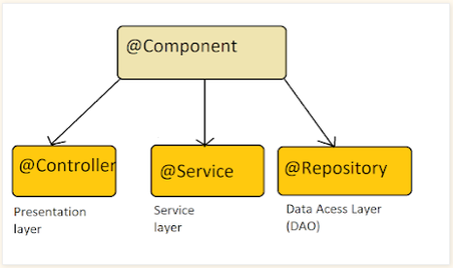

Slide 38
Exploring Spring – Dependency Injection Types
Constructor-based: Dependencies are set by creating the Bean using its Constructor.
Setter-based: Dependencies are set by creating setter methods on your beans.
Field : No setter or Constructor. Dependency is injected using reflection.
Which one should you use?
spring team recommends constructor-based injection as dependencies are automatically set when an object is created!

Slide 39
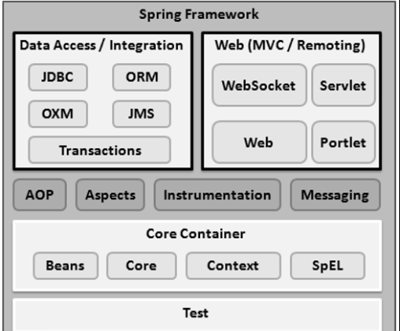
Spring Modules

Slide 40
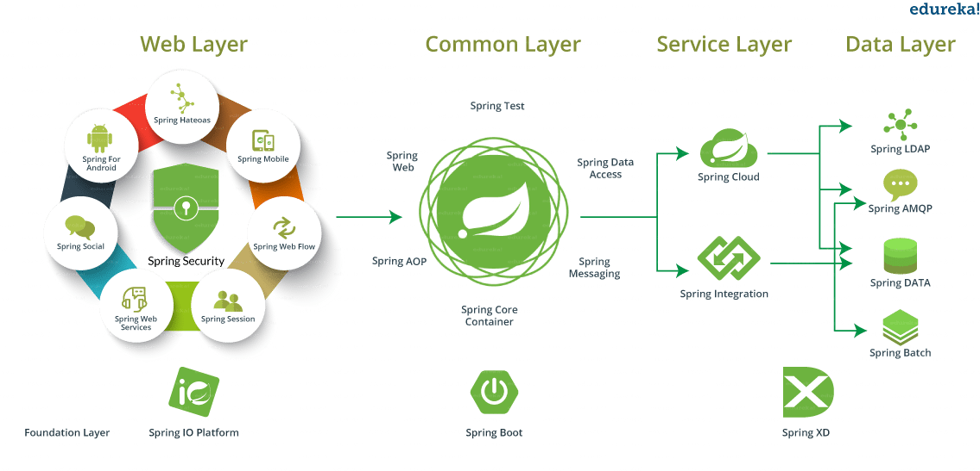
Spring Projects

Slide 41
Spring Boot

Slide 42
Getting Started with Spring Boot - Goals
Build a Hello World App in Modern Spring Boot Approach
Get Hands-on with Spring Boot.
Why Spring Boot?
Terminology
Spring Initilizer
Auto Configuration
Starter Projects
Actuator
Developer Tools

Slide 43
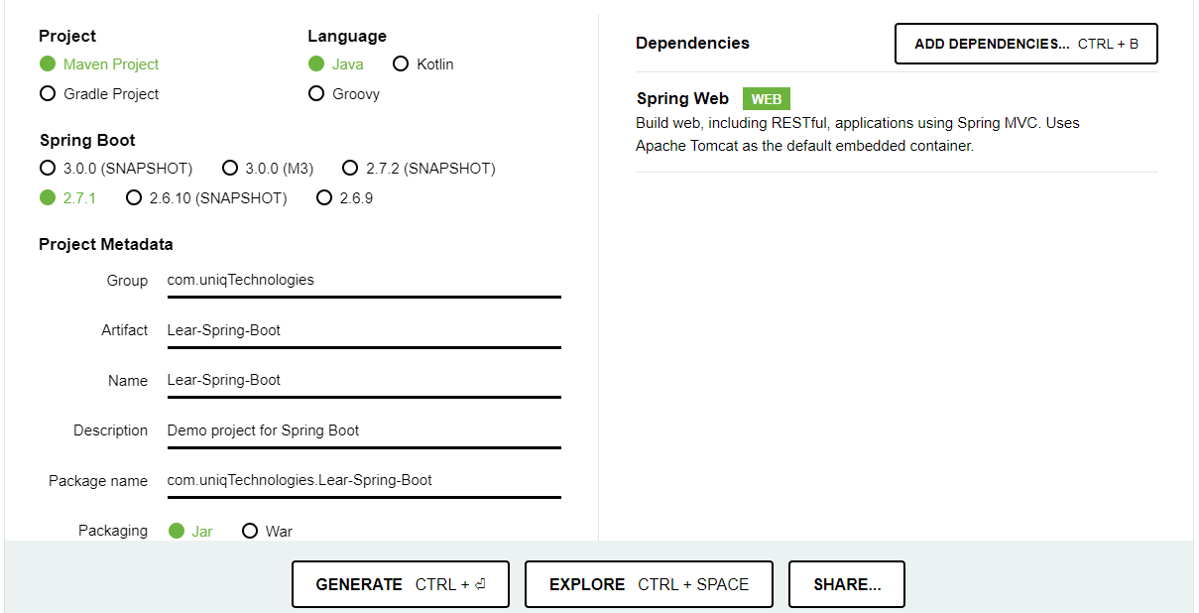
Creating Spring Boot Project - https://start.spring.io/

Slide 44
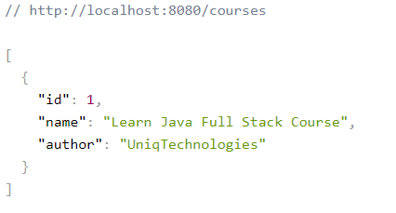
Hands-on: Understand Power of Spring Boot
//http://localhost:8080/courses
Let's Build a Hello World App using Spring Initializr
Setup CoursesController

Slide 45
Spring – MVC Framework
Spring MVC Framework follows the Model-View-Controller design pattern.
It is used to develop web applications.
It works around DispatcherServlet.
DispatcherServlet handles all the HTTP requests and responses. It dispatches the requests to handlers.
It uses @Controller and @RequestMapping as default request handlers.
The @Controller annotation defines that a particular class is a controller.
@RequestMapping annotation maps web requests to Spring Controller methods.

Slide 46
The terms model, view, and controller are as follows:
Model: The Model encapsulates the application data.
View: View renders the model data and also generates HTML output that the client’s browser can interpret.
Controller: The Controller processes the user requests and passes them to the view for rendering.

Slide 47
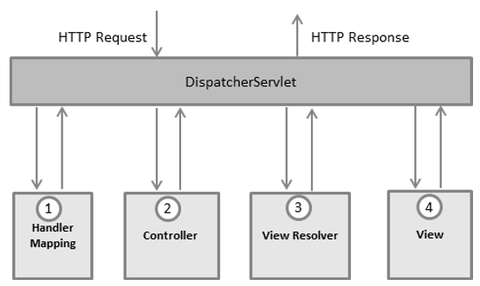
Spring MVC Flow

Slide 48
Spring MVC Framework works as follows:
All the incoming requests are intercepted by the DispatcherServlet that works as the front controller.
The DispatcherServlet then gets an entry of handler mapping from the XML file and forwards the request to the controller.
The object of ModelAndView is returned by the controller.
The DispatcherServlet checks the entry of the view resolver in the XML file and invokes the appropriate view component.

Slide 49
Create Your First Spring MVC Application
Consider the following example:
Step 0: Setup your project with maven use the required archtype to get the required folders directory and configure the server with your project.
Step 1: Load the spring jar files or add the dependencies if Maven is used. Add the following dependencies in pom.xml

Slide 50
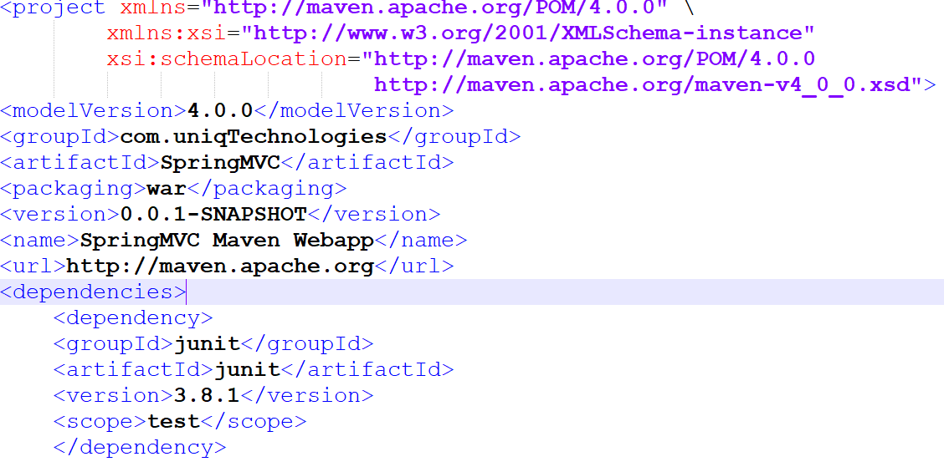
Pom.xml

Slide 51
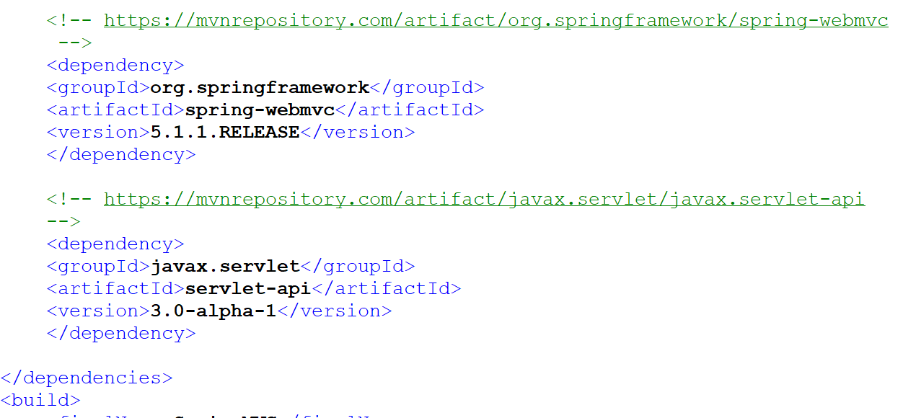
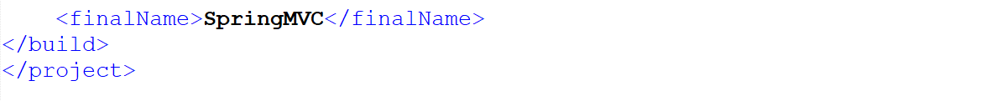

Slide 52
Step 2: Create the Controller Class
@Controller
public class HelloGeek {
@RequestMapping("/")
public String display()
{
return "hello";
}
}

Slide 53
Step 3: Provide the name of the controller in the web.xml file as follows:
DispatcherServlet is the front controller in Spring Web MVC. Incoming requests for the HTML file are forwarded to the DispatcherServlet.

Slide 54
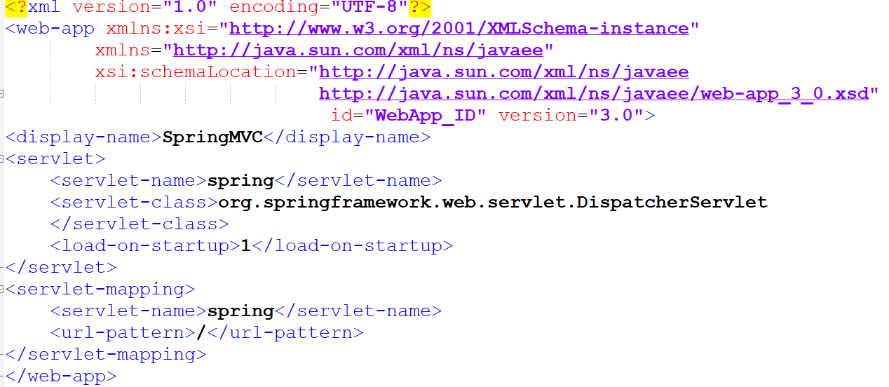
Web.xml

Slide 55
Step 4: We have to define the bean in a separate XML file. We have specified the view components in this file. It is located in the WEB-INF directory.
spring-servlet.xml

Slide 56
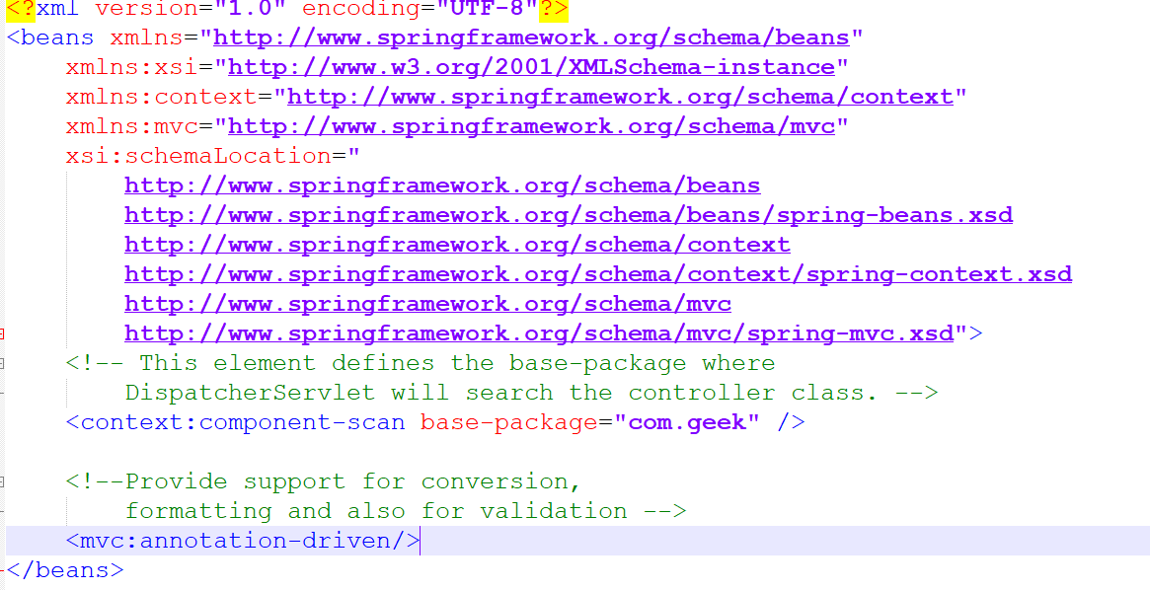
spring-servlet.xml

Slide 57
Step 5: Use JSP to display the message
index.jsp
<html>
<body>
<p>Spring MVC Tutorial!!</p>
</body>
</html>
Step 6: Start the server and run the project.

Slide 58
World Before Spring Boot!
Setting up Spring Web Projects before Spring Boot was NOT easy!
Define Maven dependencies and manage versions for frameworks(Pom.xml)
Spring-webmvc,jackson-databind,log4j etc.
Define web.xml(/src/main/webapp/WEB-INF/web.xml)
Define Front Controller for Spring Framework(DispatcherServlet)
Define a Spring Context XML file(/src/main/webapp/WEB-INF/spring-servlet.xml)
Define a Component Scan(<context:component-scan base-package="com.uniq" />)

Slide 59
Continues...
Install Tomcat or use tomcat7-maven-plugin plug-in(or any other web server)
Deploy and Run the application in Tomcat
How does Spring Boot do its MAGIC ?
Spring Boot Starter Projects.
Spring Boot Auto Configuration

Slide 60
Spring Boot Starter Projects
Goal of Starter Projects: Help you get a project up and running quickly!
Web Application – Spring Boot starter web
REST API – Spring Boot starter web
Talk to database using JPA – Spring Boot starter JPA
Talk to database using JDBC –Spring boot starter JDBC
Secure your web application or REST API – Spring Boot Starter Security
Manage list of maven dependencies and versions for different kinds of apps:
Spring Boot starter web: Frameworks needed by typical web applications
Spring-webmvc, spring-web, spring-boot-starter-tomcat, spring-boot-starter-json

Slide 61
Spring Boot Auto Configuration:
Spring Boot Provides Auto Configuration
Basic Configuration to run your application using the frameworks defined in your maven dependencies.
Auto Configuration is decided based on:
Which frameworks are in the+ class path ?
What is the existing configuration (Annotations etc)?

Slide 62
Continues...
An Example: (Enable debug logging for more details):
If you use spring starter web, following are auto configured:
Dispatcher Servlet (DispatcherServletAutoConfiguration)
Embedded Servlet Container – Tomcat is the default(EmbeddedWebServerFactoryCustomizerAutoConfiguration)
Default Error Pages(ErrorMvcAutoConfiguration)
Bean to/from JSON conversion
(JacksonHttpMessageConvertersConfiguration)
spring-boot-autoconfigure-2.7.1.jar
DispatcherServlet
@ConditionalonwebApplication
@ConditionalonClass
@SpringBootConfiguration
@EnableAutoConfiguration
@ComponentScan
@SpringBootApplication

Slide 63
Spring Boot Embedded Servers
How do you deploy your application?
Step 1: Install Java
Step 2: Install web/Application server
Tomcat/glassfish/websphere
Step 3: Deploy the application WAR (Web Archive)
This is the old WAR Approach
Embedded Server – Simpler alternative
Step 1: Install Java
Step 2: Run JAR File
Maven build clean install to generate jar file
Java –jar JAR_NAME.jar

Slide 64
More Spring Boot Features
Spring Boot Actuator : Monitor and manage your application in your production.
Provides a number of endpoints:
beans – Complete list of spring bean in your app
health - Application health information
metrics – Application metrics
mappings – details around request mappings
<dependency> <groupId>org.springframework.boot</groupId> <artifactId>
spring-boot-starter-actuator
</artifactId>
</dependency>
management.endpoints.web.exposure.include=*
management.endpoints.web.exposure.include=health,metrics

Slide 65
Spring Boot Devtools:
Increase developer productivity
Why do you need to restart the server for every code change ?
<dependency> <groupId>org.springframework.boot</groupId> <artifactId>spring-boot-devtools</artifactId> <scope>runtime</scope> </dependency>

Slide 66
Spring Boot vs Spring MVC vs Spring
Spring Framework Core Feature: Dependency Injection
@component, @Autowired, IOC Container, ApplicationContext, Component Scan etc..
Spring Modules and Spring Projects : Good Integration with Other Frameworks (Hibernate/JPA, Junit & Mockito for Unit Testing)

Slide 67
Spring MVC
Spring MVC (Spring Module): Build Web Applications in a decoupled approach
Dispatcher Servlet, ModelAndView and ViewResolver etc

Slide 68
Spring Boot
Spring Boot(Spring Project): Build production ready applications quickly
Starter Projects – Makes it easy to build variety of applications
Auto Configuration – Eliminate configuration to setup spring, Spring MVC and other projects!
Enable production ready non functional features:
Actuator: Enables Advanced Monitoring and Tracing of applications.
Embedded Servers – No need for separate application servers!
Default error handling

Slide 69
RESTful Web Services
Basics :
HTTP Request Methods
GET
POST
DELETE
Exception Handling
Validation
HATEOAS
HTTP Response Status
200, 400, 404

Slide 70
Advanced
Versioning
Swagger
Filtering
Monitoring
Content Negotiation
Internationalization

Slide 71
Tools/Frameworks:
Spring
Spring Boot
JPA
Maven
Postman

Slide 72
Basics of RESTful Services
Step 01 - Initializing a RESTful Services Project with Spring Boot
Step 02 - Understanding the RESTful Services we would create in this course
Step 03 - Creating a Hello World Service
Step 04 - Enhancing the Hello World Service to return a Bean
Step 05 - Quick Review of Spring Boot Auto Configuration and Dispatcher Servlet - What's happening in the background?
Step 06 - Enhancing the Hello World Service with a Path Variable
Step 07 - Creating User Bean and User Service
Step 08 - Implementing GET Methods for User Resource
Step 09 - Implementing POST Method to create User Resource
Step 10 - Enhancing POST Method to return correct HTTP Status Code and Location URI
Step 11 - Implementing Exception Handling - 404 Resource Not Found
Step 12 - Implementing Generic Exception Handling for all Resources
Step 13 - Exercise : User Post Resource and Exception Handling
Step 14 - Implementing DELETE Method to delete a User Resource
Step 15 - Implementing Validations for RESTful Services
Step 16 - Implementing HATEOAS for RESTful Services

Slide 73
Advanced RESTful Service Features
Step 17 - Overview of Advanced RESTful Service Features
Step 18 - Internationalization for RESTful Services
Step 19 - Content Negotiation - Implementing Support for XML
Step 20 - Configuring Auto Generation of Swagger Documentation
Step 21 - Introduction to Swagger Documentation Format
Step 22 - Enhancing Swagger Documentation with Custom Annotations
Step 23 - Monitoring APIs with Spring Boot Actuator
Step 24 - Implementing Static Filtering for RESTful Service
Step 25 - Implementing Dynamic Filtering for RESTful Service

Slide 74
Connecting RESTful Service to JPA
Step 26- Overview of Connecting RESTful Service to JPA
Step 27 - Creating User Entity and some test data
Step 28 - Updating GET methods on User Resource to use JPA
Step 29 - Updating POST and DELETE methods on User Resource to use JPA
Step 30 - Creating Post Entity and Many to One Relationship with User Entity
Step 31 - Implementing a GET service to retrieve all Posts of a User
Step 32 - Implementing a POST service to create a Post for a User

Slide 75
Creating Spring Project with dependencies
https://start.spring.io/
Dependencies :
Spring Web
Spring Boot DevTools
Spring Data JPA
H2 Database

Slide 76
RESTful Webservice

Slide 77
REST
Representational State Transfer
REST is a style of software architecture for distributed hypermedia systems

Slide 79
KEY ABSTRACTION - RESOURCE
A resource has an URI (Uniform Resource Identifier)
/users/uniq/todos/1
/users/uniq/todos
/users/uniq
A resource can have different representations
XML
HTML
JSON

Slide 80
EXAMPLE
Create a User – POST/users
Delete a User – DELETE/users/1
Get all Users – GET/users
Get one Users – GET/users/1
#Restful Web Services
Retrieve all users - GET /users
Create a user – POST /users
Retrieve one user – GET /users/{id} -> /users/1
Delete a user - DELETE /users/{id} -> /users/1

Slide 81
Social Media Application
User - > Posts
Retrieve all posts for a user – GET /users/{id}/posts
Create a posts for a User – POST /users/{id}/posts
Retrieve details of a post – GET /users/{id}/posts/{post_id}

Slide 82
Step 03 - Creating a Hello World Service
Step 04 - Enhancing the Hello World Service to return a Bean
Step 05 - Quick Review of Spring Boot Auto Configuration and Dispatcher Servlet - What's happening in the background?

Slide 83
What’s happening in background?
## Question to Answer
What is dispatcher Servlet?
Who is configuring dispatcher Servlet?
What does dispatcher Servlet do?
How does the HelloWorldBean object get converted to JSON?
Who is configuring the error mapping?

Slide 84
First start the application to debug mode
logging.level.org.springframework = DEBUG
Spring boot Auto Configuration
Mapping Servlet: ‘dispactherServlet’ to [/] – this plays a key role in Spring Boot Application.

Slide 85
Swagger
https://springdoc.org/
<dependency> <groupId>org.springdoc</groupId> <artifactId>springdoc-openapi-ui</artifactId> <version>1.6.9</version> </dependency>
http://localhost:8080/swagger-ui/index.html
http://localhost:8080/v3/api-docs

Slide 86
Actuator
<dependency>
<groupId>org.springframework.boot</groupId>
<artifactId>spring-boot-starter-actuator</artifactId>
</dependency>

Slide 87
Hal Explorer
<dependency>
<groupId>org.springframework.data</groupId>
<artifactId>spring-data-rest-hal-explorer</artifactId>
</dependency>
http://localhost:8080/

Slide 88
Introduction to JPA
Java is an object oriented Programming language. In java, all data is stored in Objects.
Typically, Relational database are used to store data(These days, a number of other NoSQL data stores are also becoming popular. We will still away from them, for now). Relational database store data in Tables
The way we design Objects is different from the way the relational databases are designed. This results is an impedence mismatch.

Slide 89
First 10 Steps in JPA with H2 in-memory database
Step 1 : Object Relational Impedence Mismatch - Understanding the problem that JPA solves
Step 2 : World before JPA - JDBC, Spring JDBC and myBatis
Step 3 : Introduction to JPA
Step 4 : Creating a JPA Project using Spring Initializr
Step 5 : Defining a JPA Entity - User
Step 6 : Defining a Service to manage the Entity - UserService and EntityManager
Step 7 : Using a Command Line Runner to save the User to database.
Step 8 : Magic of Spring Boot and In Memory Database H2
Step 9 : Introduction to Spring Data JPA
Step 10 : More JPA Repository : findById and findAll
Next Steps

Slide 90
Object Oriented programming consists of concepts like encapsulation, inheritance, Interfaces and polymorphism.
Relational databases are made up of Tables with concepts like normalization.

Slide 91
Examples of Object Relational Impedence Mismatch
Lets consider a simple example – Employees and Tasks
Each Employee can have multiple Task. Each Task can be shared by multiple Employees.
There is Many to Many relationship between them. Lets Consider a few examples of Impedence Mismatch.

Slide 92
Example 1:
Class Task below is mapped to Task Table. However, there are mismatches in column names.
Public class Task{
Private int id;
Private String desc;
Private Date targetDate;
Private boolean isDone;
Private List<Employee> employees;
}

Slide 93
CREATE TABLE task
{
id INTEGER GENERATED BY DEFAULT AS IDENTITY,
Description VARCHAR(255),
Is_done BOOLEAN,
target_date TIMESTAMP,
PRIMARY KEY (id)
}

Slide 94
EXAMPLE 2:
Relationships between objects are expressed in a different way compared with relationship between tables.
Each Employee can have multiple Tasks. Each task can be shared by multiple Employees. There is a Many to Many relationship between them.

Slide 95
Public class Employee
{
//some other code
Private List<Task> tasks;
}
public class Task
{
//some other code
Private List<Employees> employees;
}

Slide 96
CREATE TABLE employee
(
Id BIGINT NOT NULL,
OTHER_COLUMNS
)
CREATE TABLE employee_tasks
(
employees_id BIGINT NOT NULL,
tasks_id INTEGER NOT NULL
)
CREATE TABLE tasks
(
id INTEGER GENERATED BY DEFAULT AS IDENTITY,
OTHER_COLUMNS
)

Slide 97
Example 3:
Sometimes multiple classes are mapped to a single table and vice-versa
Objects
Public class Employee{
//other Employee Attributes
}
Public class FullTimeEmployee extends Employee{
Protected Integer salary;
}
Public class PartTimeEmployee extends Employee{
Protected Float hourlywage;
}

Slide 98
Tables
CREATE TABLE employee
(
employee_type VARCHAR(31) NOT NULL,
Id BIGINT NOT NULL,
city VARCHAR(255),
state VARCHAR(255),
street VARCHAR(255) ,
zip VARCHAR(255) ,
hourly_wage FLOAT, -- PartTimeEmployee
salary INTEGER , --FullTimeEmployee
PRIMARY KEY (id)
)

Slide 99
World Before JPA : JDBC , Spring JDBC
JDBC or Java Database Connectivity is a Java API to connect and execute the query with the database.

Slide 100
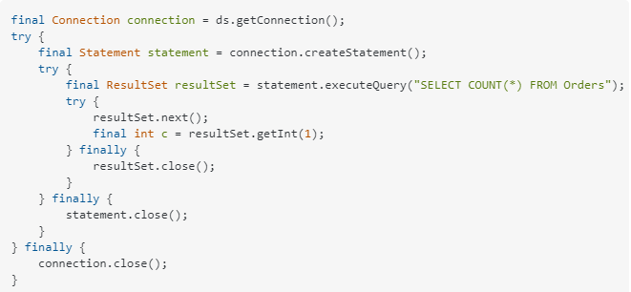
Let me show you some simple example using JDBC:

Slide 101
Spring JDBC
Spring JDBC provides a layer on top of JDBC
It used concepts like JDBCTemplate
Typically needs lesser number of lines compared to JDBC as following are simplified
Mapping parameters to queries
Liquidating resultsets to beans
you can extract common code and use template method Design Pattern. Effectively you'd reinvent JDBCTemplate:

Slide 102
final int c = new JdbcTemplate(ds).queryForInt("SELECT COUNT(*) FROM Orders");
Also Spring JDBC provides exception translation (no more checked SQLException

Slide 103
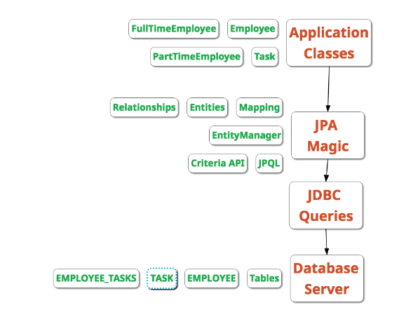
Introduction to JPA

